Slide 1
Automation and Manual Testing of Amazon E-Commerce Website
Using Selenium WebDriver, TestNG, and Page Object Model
-NANDHINI Ganesan MCA

Slide 2
Project Objective
To validate the functionality of Amazon e-commerce website through manual testing and automation testing.
To ensure all modules such as Homepage, Search, Product Listing, Navigation, Login, and Footer are working correctly.
To prepare for automation testing using Selenium WebDriver and TestNG in the future.
To provide a complete QA workflow project for academic and professional review.

Slide 3
Technologies Used
Java JDK – Required for Selenium and automation code
Eclipse IDE – Writing and running automation scripts
EXCEL – Tools for manual testing
Selenium WebDriver – Automating browser actions
TestNG – Running tests and generating reports
Chrome Driver – Connecting Selenium with Google Chrome

Slide 4
Manual Testing
Manual Testing is the process of testing a software application without using automation tools.
Testers execute test cases manually and verify if the software behaves as expected.
Helps in identifying bugs, errors, and functional issues before automation.
Steps followed in manual testing (for Amazon project):
Requirement Understanding – Analyze website modules and functionality.
Test Scenario Creation – Identify all possible scenarios to test.
Test Case Writing – Write step-by-step instructions with expected results.
Test Execution – Execute the test cases manually and record results.
Bug Reporting – Report any issues found in a bug tracking tool (Jira).
Manual testing ensures all critical functionalities like Homepage, Search, Product Listing, Login,
Navigation, and Footer links work correctly.

Slide 5
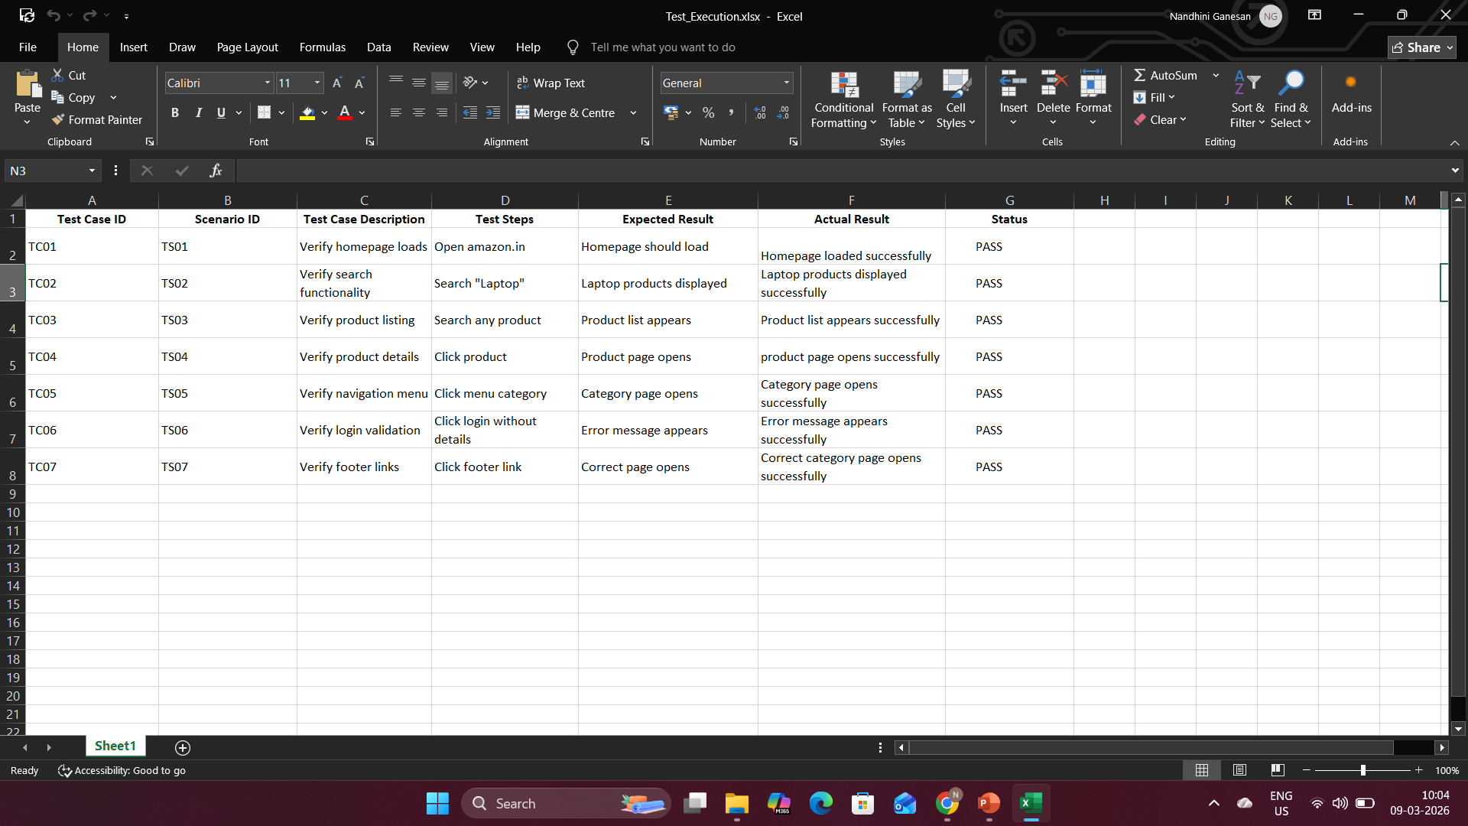
Test Cases Execution

Slide 6
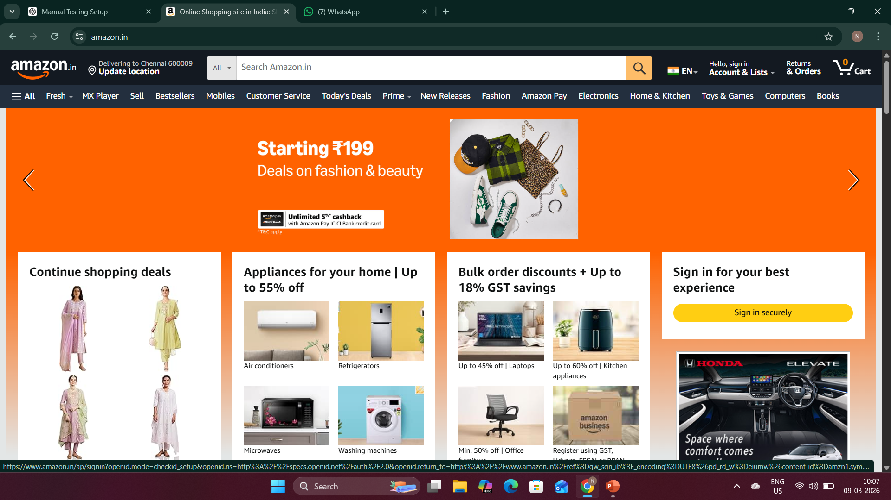
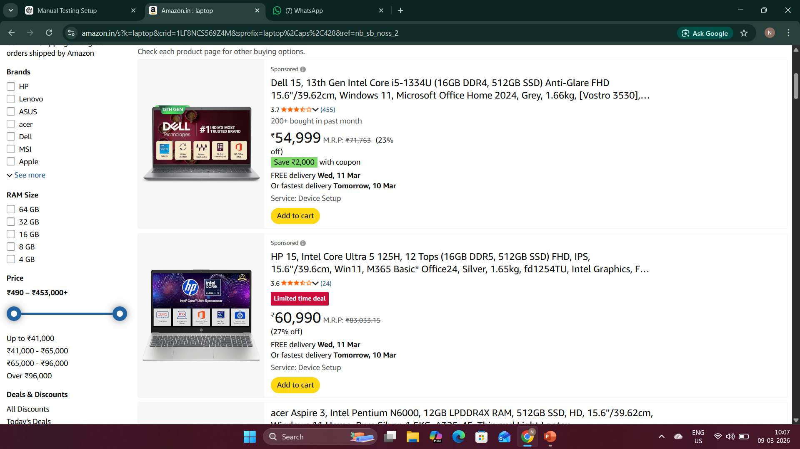
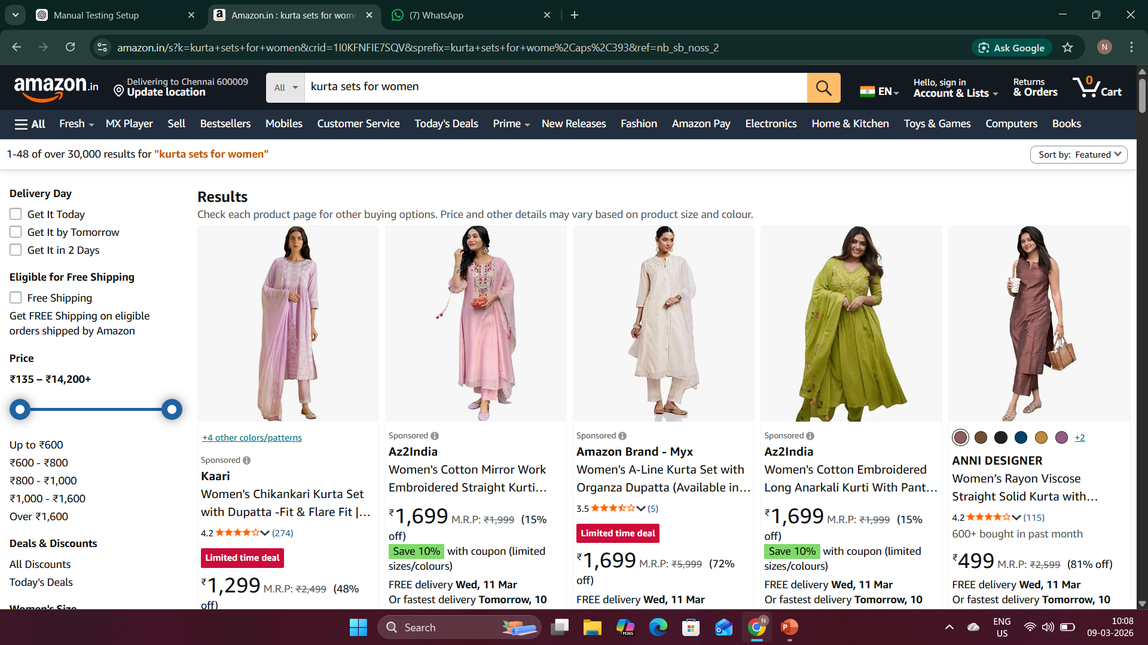
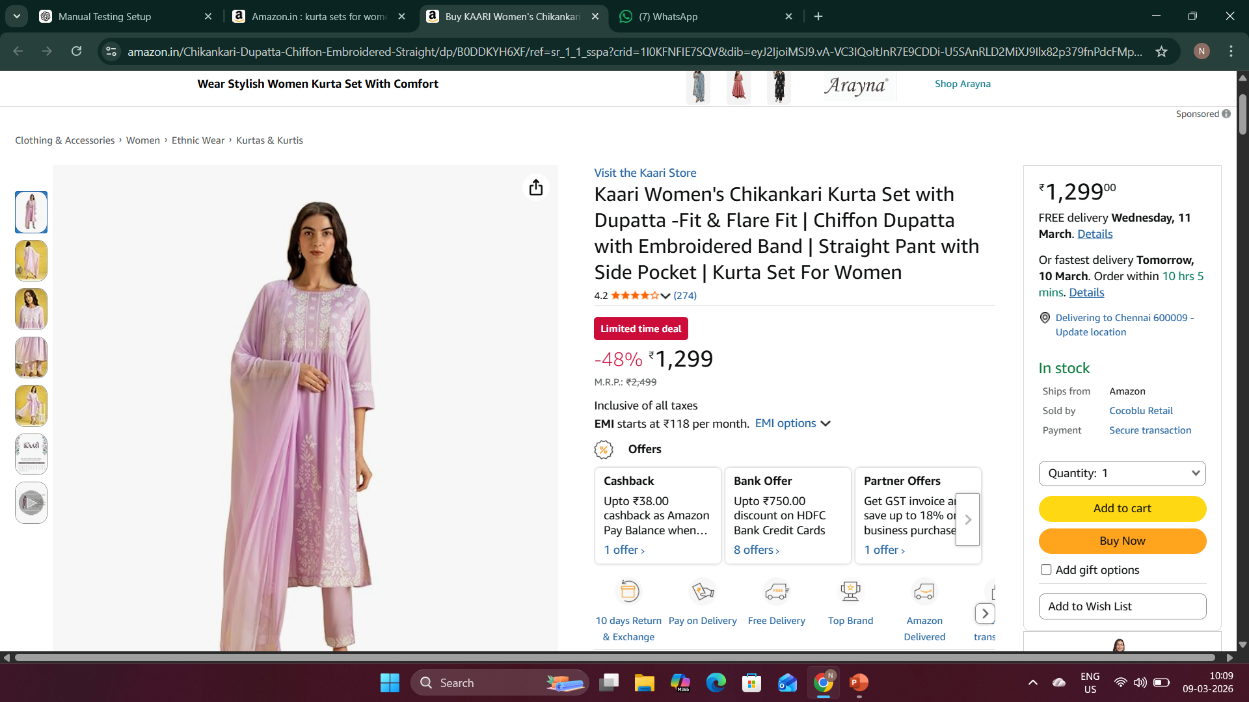
Sample Execution

Slide 7
Automation Testing – Future Work
What is Automation Testing?
Using tools and scripts to test software automatically instead of manually.
Speeds up testing, increases accuracy, and generates reports.
Planned Test Cases:
Homepage Load Verification – Homepage opens and title correct
Product Search Validation – Search results verified
Product Listing Verification – Categories and products display correctly
Product Details Verification – Product page details correct

Slide 8
Automation Testing – Future Work
Benefits:
Faster and repeatable
Reduces human error
Generates detailed reports
Next Steps:
Set up Eclipse project with Selenium & TestNG
Implement automation scripts for all planned test cases
Run scripts and validate execution reports

Slide 9
Conclusion
Manual testing of the Amazon e-commerce website was completed successfully, and all major modules, including Homepage, Search, Product Listing, Navigation, Login, and Footer links, were thoroughly verified. No critical bugs were found during testing, ensuring that the website functions as expected.
The next phase of the project involves automation testing using Selenium WebDriver and TestNG. This will help improve the speed, accuracy, and repeatability of tests, and will allow us to generate detailed execution reports for better analysis.
Overall, the project demonstrates a complete QA workflow, following industry standards, and prepares a strong foundation for real-world applications and future enhancements. It also provides a professional showcase for academic and interview purposes.

